Slide 1
Challenge 2 Extension
When the TOUCH sensor touched, Challenge 2 asked you to
Back up a bit (a fixed amount)
Then turn right 90 degrees (a fixed amount)
Modify your challenge 2 to
Backup a variable amount (between 0.5 and 2 rotations)
Then turn left or right a variable amount (say up to 60 degrees)

Slide 2
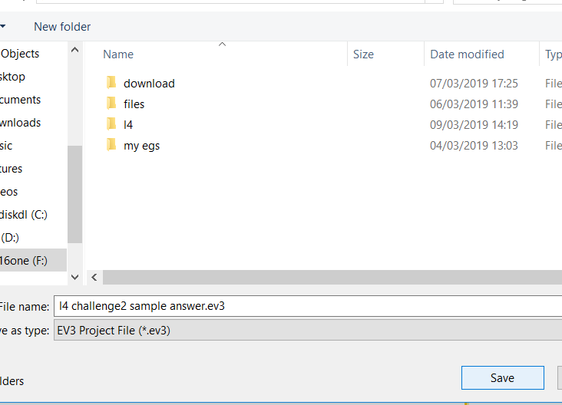
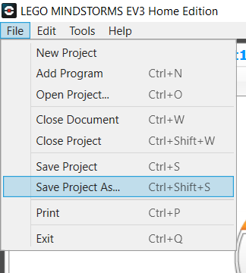
Save your current challenge 2
First step is save your challenge 2 program so that if you make some errors you can always go back to the last working program.
File > save project as..

Slide 3
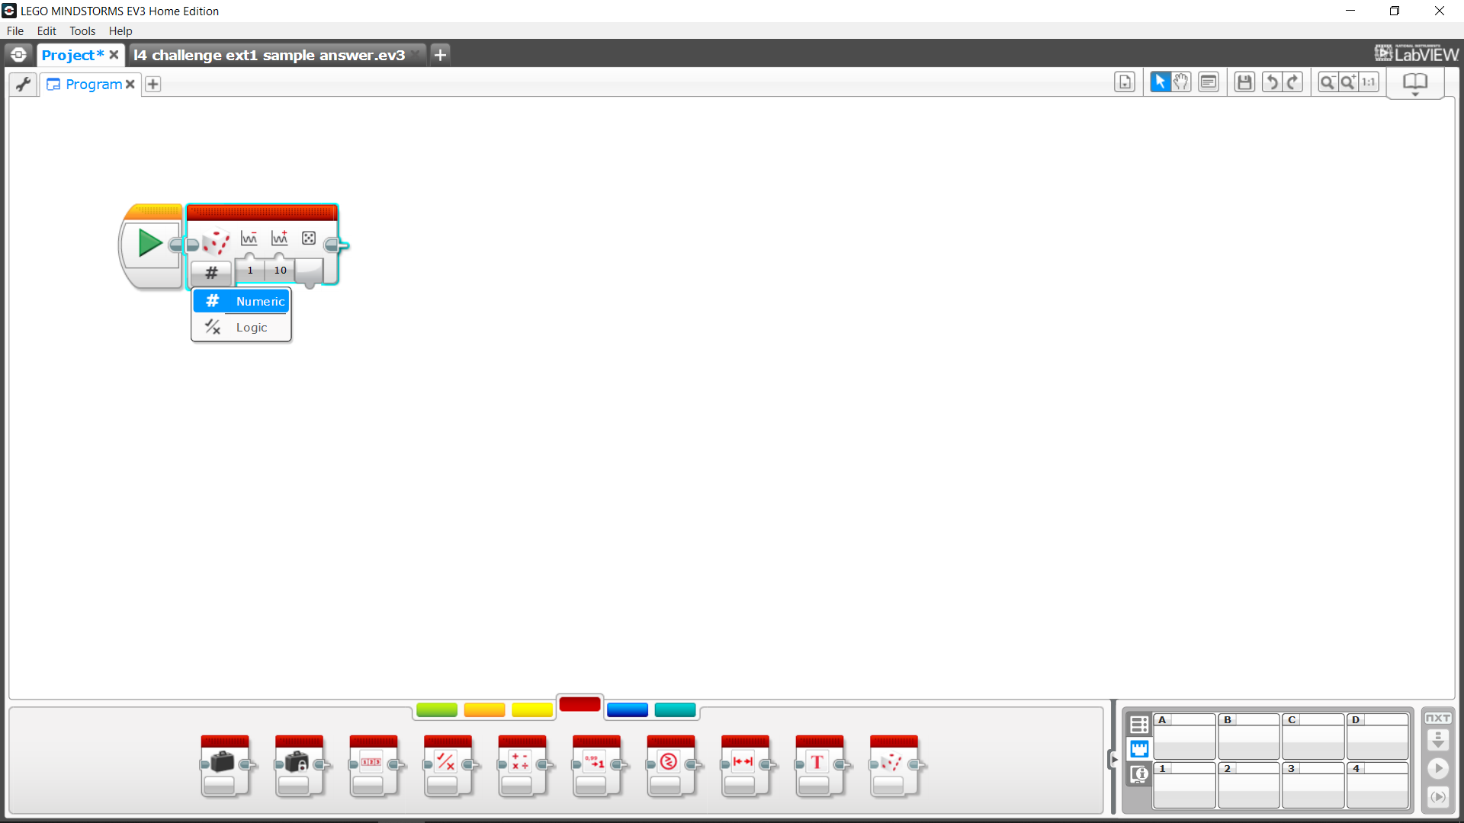
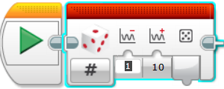

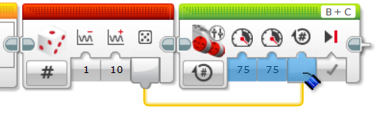
Random numbers – How To
Select Random Block and insert before your desired action
Select “Numeric” on Random
Set a lower and upper value for the required random number
Drag from random number to desired block number

